Slide 1

CODE RED 3.0
CODE TILL YOU DROP
InfraScatter Sentinel Integrated IR Scatter Intelligence and Ranger Authentication System for Wildlife Corridors
Problem Statement Code: CR(H)3: Multi-Sensor Wildlife Corridor Monitoring System for Anti-Poaching Using ESP32 and Raspberry Pi
Team Name: Team InfraRed
Team Leader Name: Jiya Kulkarni
Institution Name: BMS Institute Of Technology

Slide 2

Why This Project is Needed
1.Why We Are Doing This
Our forests are facing rapid loss of wildlife due to poaching, deforestation, and illegal human activities.
• Many endangered species are at risk because existing monitoring systems are either costly or fail in dense forest conditions.
• To protect wildlife and ensure safe movement in corridors, smart sensor-based systems are needed for real-time detection and alerting.
2.Examples of Deforestation and Wildlife Threats
• Deforestation in the Western Ghats – leading to loss of habitats for elephants and tigers.
• Illegal logging in Amazon and Indian Forests – causing soil erosion and ecosystem imbalance.
• Poaching incidents in Nagarhole and Bandipur Reserves – reducing animal populations.
• Forest fires and encroachment – destroying green cover and migration paths.
3.Goal:
• To build an affordable, intelligent, and contactless monitoring system that helps forest departments detect intrusions, track animal movement, and prevent poaching in real time.

Slide 3
IDEA/APPROACH DETAILS
IDEA/APPROACH DETAILS
Idea and Solution:
InfraScatter Sentinel is a dual layer wildlife protection system that combines ground-level infrared scatter sensing with secure contactless ranger authentication.
Distributed nodes project a thin sheet of invisible infrared light a few centimeters above the forest floor. When a human, animal, or vehicle passes through, the soil, leaves and body mass distort the scatter pattern. The ESP32 based node analyses this signature along with vibration and microthermal readings using an edge-ML model to classify the event in real time.
A complementary authentication terminal uses near infrared palm vein recognition to ensure only authorized rangers can access system logs, acknowledge alerts or trigger response actions. This creates a complete detection, decision and authorization ecosystem.

Slide 4
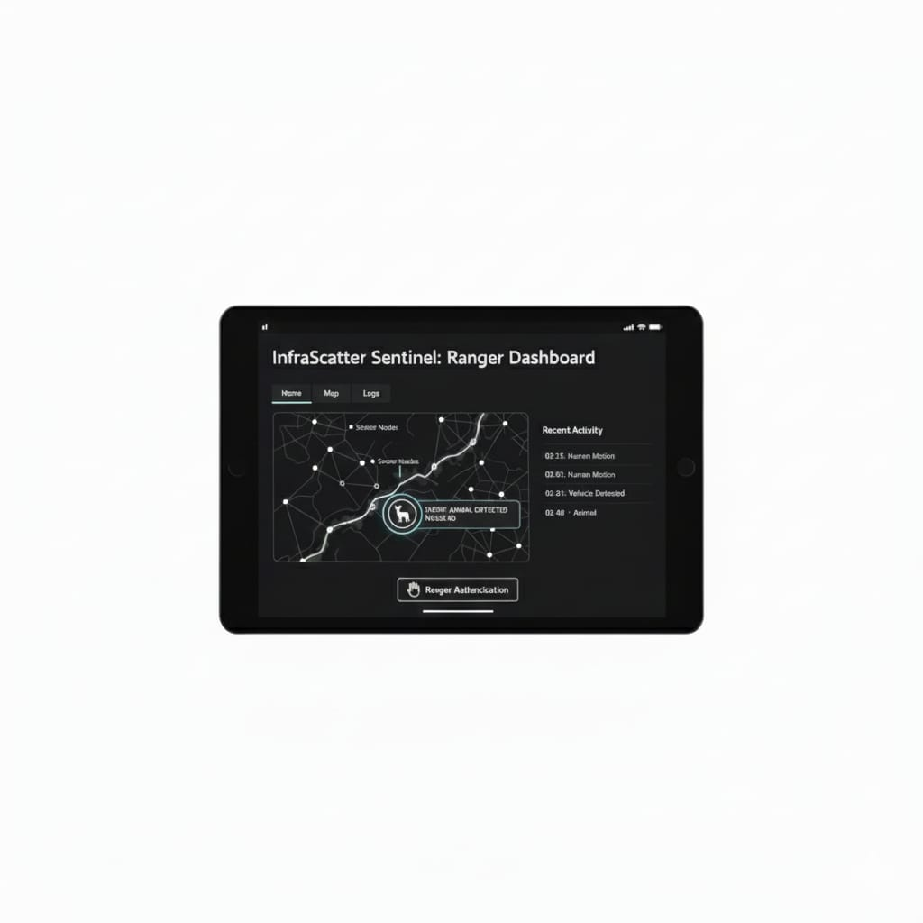
GTM (Go-To-Market) Strategy
We will sell our InfraScatter Sentinel system (IR sensors + gateway + ranger scanner) to forest departments and NGOs.
Main income sources:
  Selling the hardware (sensor kits).
  Charging for yearly service, maintenance, and data dashboard use.
Why it’s useful:
  • Detects poachers and animals quickly.
  • Real time updates to avoid danger in forest.
  • Only authorized rangers can access it – safe and secure.
Steps to start:
1.Test it in one forest area .
2.Collect and improve data accuracy.
3.Show results to government and NGOs.
4.Start larger deployments.
5.Keep giving software updates and support.

Slide 5
GTM (Go-To-Market) Strategy
Phase | Timeline | Key Activities | Expected Outcome
Phase 1 – Pilot & Validation | 0–6 months | Deploy 10 sensor nodes + 1 gateway in a forest corridor (e.g., Bandipur). Gather real-time data, train ML model, validate detection accuracy. | Proof of concept, field validation report, ranger feedback.
Phase 2 – Government Partnerships | 6–12 months | Approach Karnataka Forest Department & Ministry of Environment. Demonstrate dashboard analytics and safety alerts. | MoU or pilot approval for wider testing.
Phase 3 – Production & Deployment | 12–24 months | Manufacture 500+ sensor units. Partner with NGOs like WWF-India for deployments. | Full corridor coverage in 3–5 regions.
Phase 4 – Commercial Expansion | 24+ months | Sell and maintain systems for other Indian states & neighboring countries. | Sustainable annual revenue stream.

Slide 6
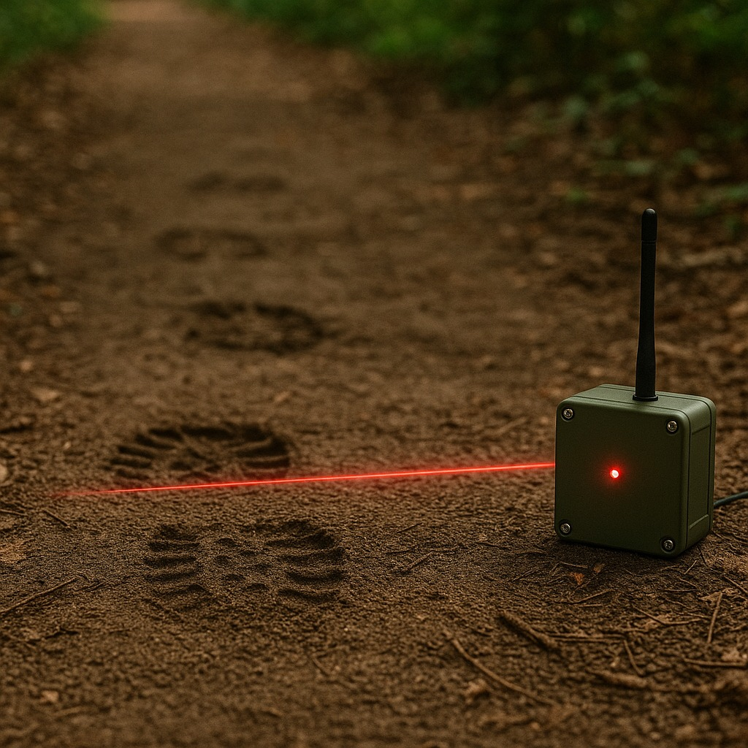
Business Model Implementation
• What We Offer:
InfraScatter Kits: ESP32-based sensor system with IR and vibration sensors.
Gateway Unit: Collects and transfers forest activity data.
Dashboard Access: For viewing real-time alerts and reports.
Maintenance & Support: Regular service and data updates.
• Revenue Sources:
Selling the complete hardware kits.
Annual subscription for dashboard and data usage.
Maintenance and software update charges.
• Steps to Implement:
1.Conduct pilot installation in one forest zone.
2.Collect data and improve detection accuracy.
3.Partner with forest departments and NGOs.
4.Start wider deployments after successful tests.
5.Offer regular maintenance and update services.

Slide 7
Business Model Implementation
Year | Units Sold | Revenue from Kits | Subscription & Support | Total Revenue | Est. Net Profit Margin
Y1 | 100 kits | ₹6,00,000 | ₹1,00,000 | ₹7,00,000 | 20%
Y2 | 500 kits | ₹30,00,000 | ₹5,00,000 | ₹35,00,000 | 30%
Y3 | 1500 kits | ₹90,00,000 | ₹15,00,000 | ₹1,05,00,000 | 35%

Slide 8
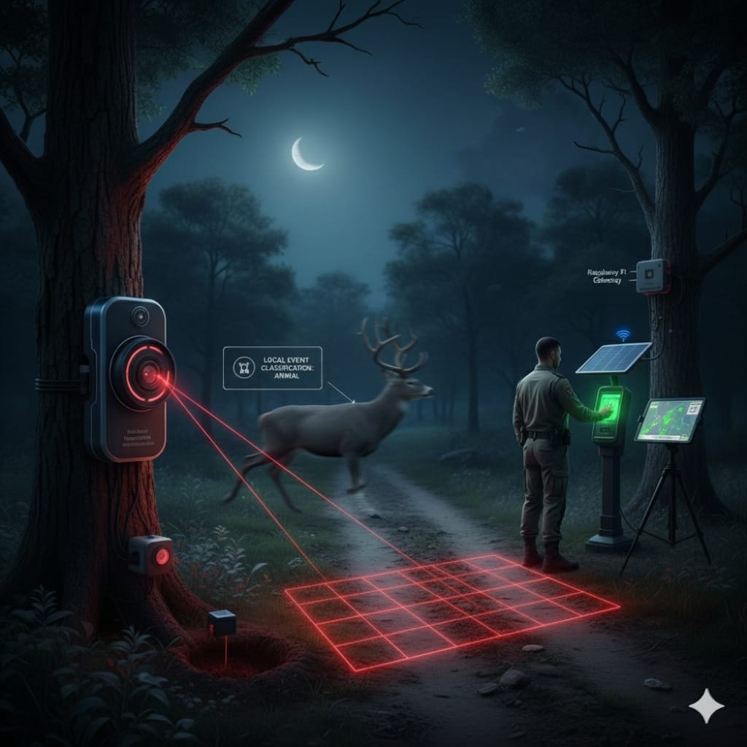
Target Market
• Main users:
  Forest departments – for anti-poaching and animal tracking.
  Wildlife researchers – for studying animal movement.
• Other possible users:
Safari zoo and other private zoo
  NGOs that protect animals.
  Private forest reserves or sanctuaries.
• Starting areas:
  Forests in Karnataka and the Western Ghats.
• Later expansion:
  Other parts of India and nearby countries like Thailand and Indonesia.

Slide 9
Target Market
Segment | Description | Market Size (Approx.) | Pain Points | How InfraScatter Helps
Government Forest Departments | 40+ forest divisions across India managing wildlife corridors. | ₹2+ Cr annual conservation tech budget (MoEFCC). | Lack of low-cost real-time monitoring; manual patrol risk. | Affordable, automated, AI-powered monitoring.
Wildlife NGOs & Research Organizations | WWF-India, WTI, Wildlife SOS, etc. | ₹5+ Cr combined project budgets yearly. | Limited real-time visibility, manual data collection. | Cloud dashboard & live event logging for analysis.
Safari Zoo, private Forest Reserves & Eco-Parks | Resorts & private sanctuaries with animal corridors. | ₹10+ Cr estimated yearly spend on surveillance. | Need reliable monitoring without costly cameras. | Easy deployment & low maintenance IR sensing.

Slide 10
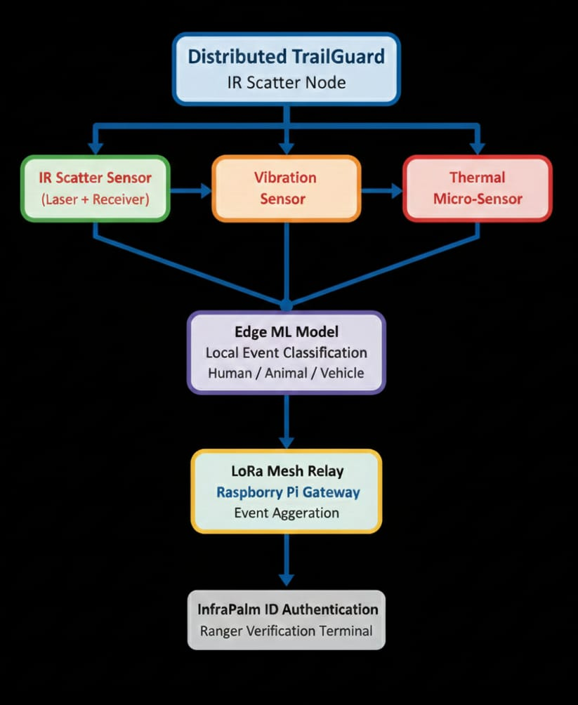
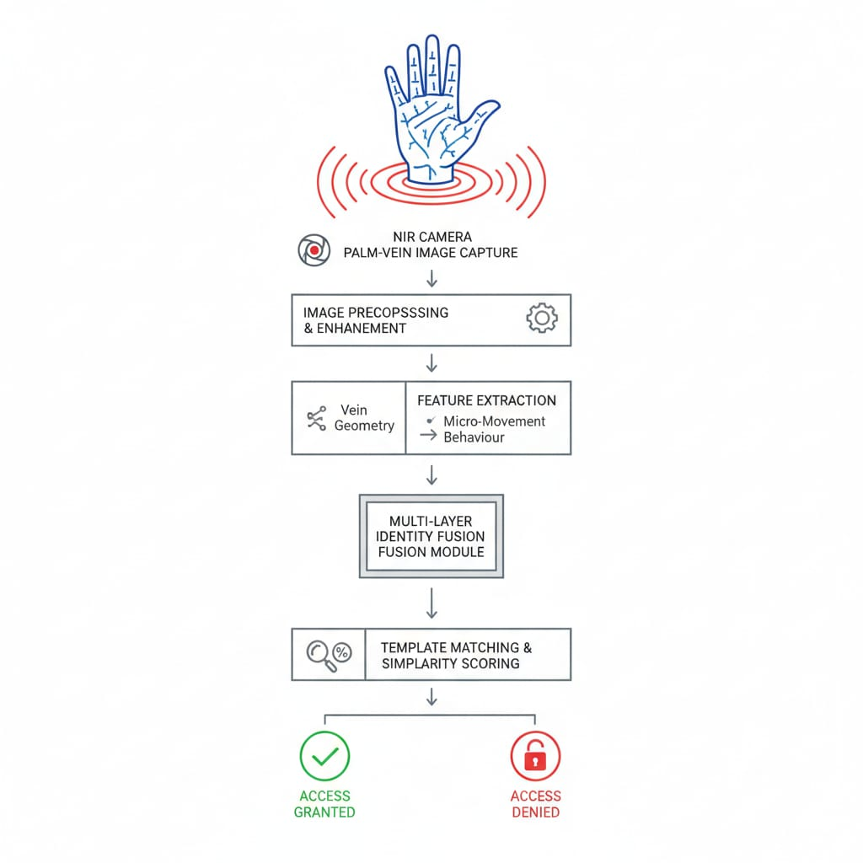
IDEA/APPROACH DETAILS
IDEA/APPROACH DETAILS

Slide 11
Components used
Component | Use | Range | Why Used in Forest
ESP32 Dev Board | Controls all sensors, sends data | Wi-Fi: ~100 m, LoRa: 2–5 km | Low-power, smart processing, remote data transfer
IR Obstacle Sensor (x2) | Detects movement / crossing objects | 2–30 cm | Detects intruders or animals using IR beam
SW-420 Vibration Sensor | Senses ground vibration | 1–2 m | Detects footsteps or vehicle movement
DHT11 | Measures temperature (and humidity) | 0–50 °C | Tracks environmental and thermal changes
Buzzer | Gives alert sound | 5–10 m | Warns rangers of intrusion
Red, Green, Yellow LEDs | Shows system status | Visible 10–15 m | Easy field indication (alert / normal / active)

Slide 12
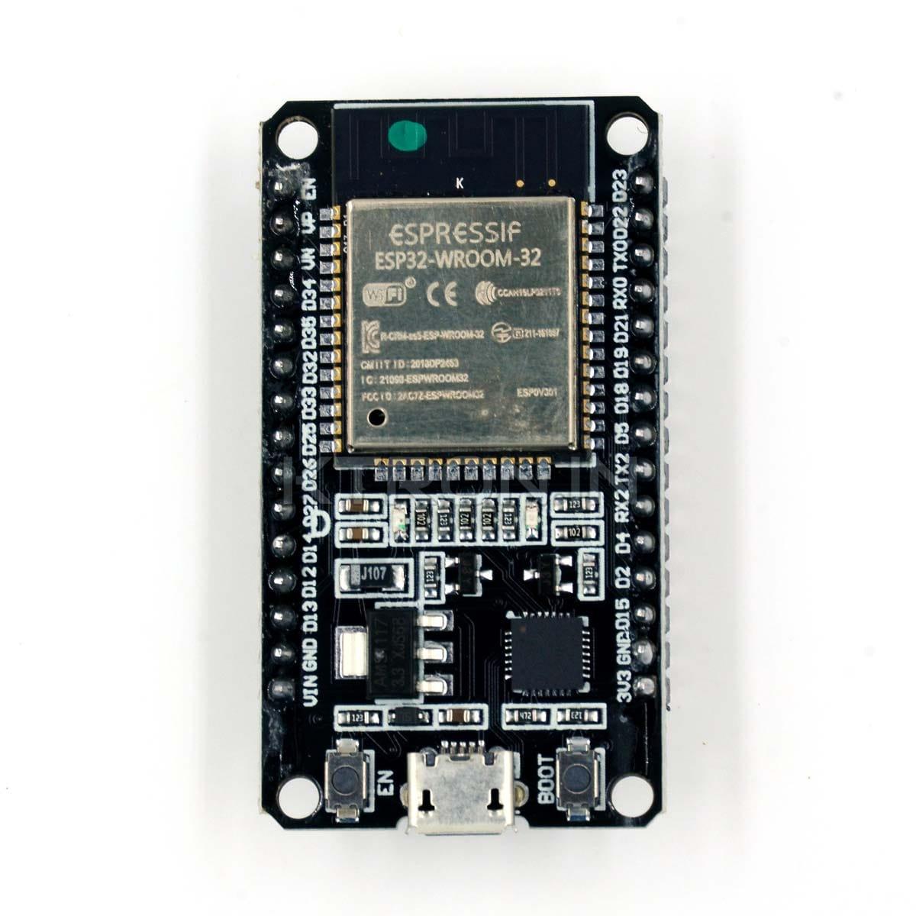
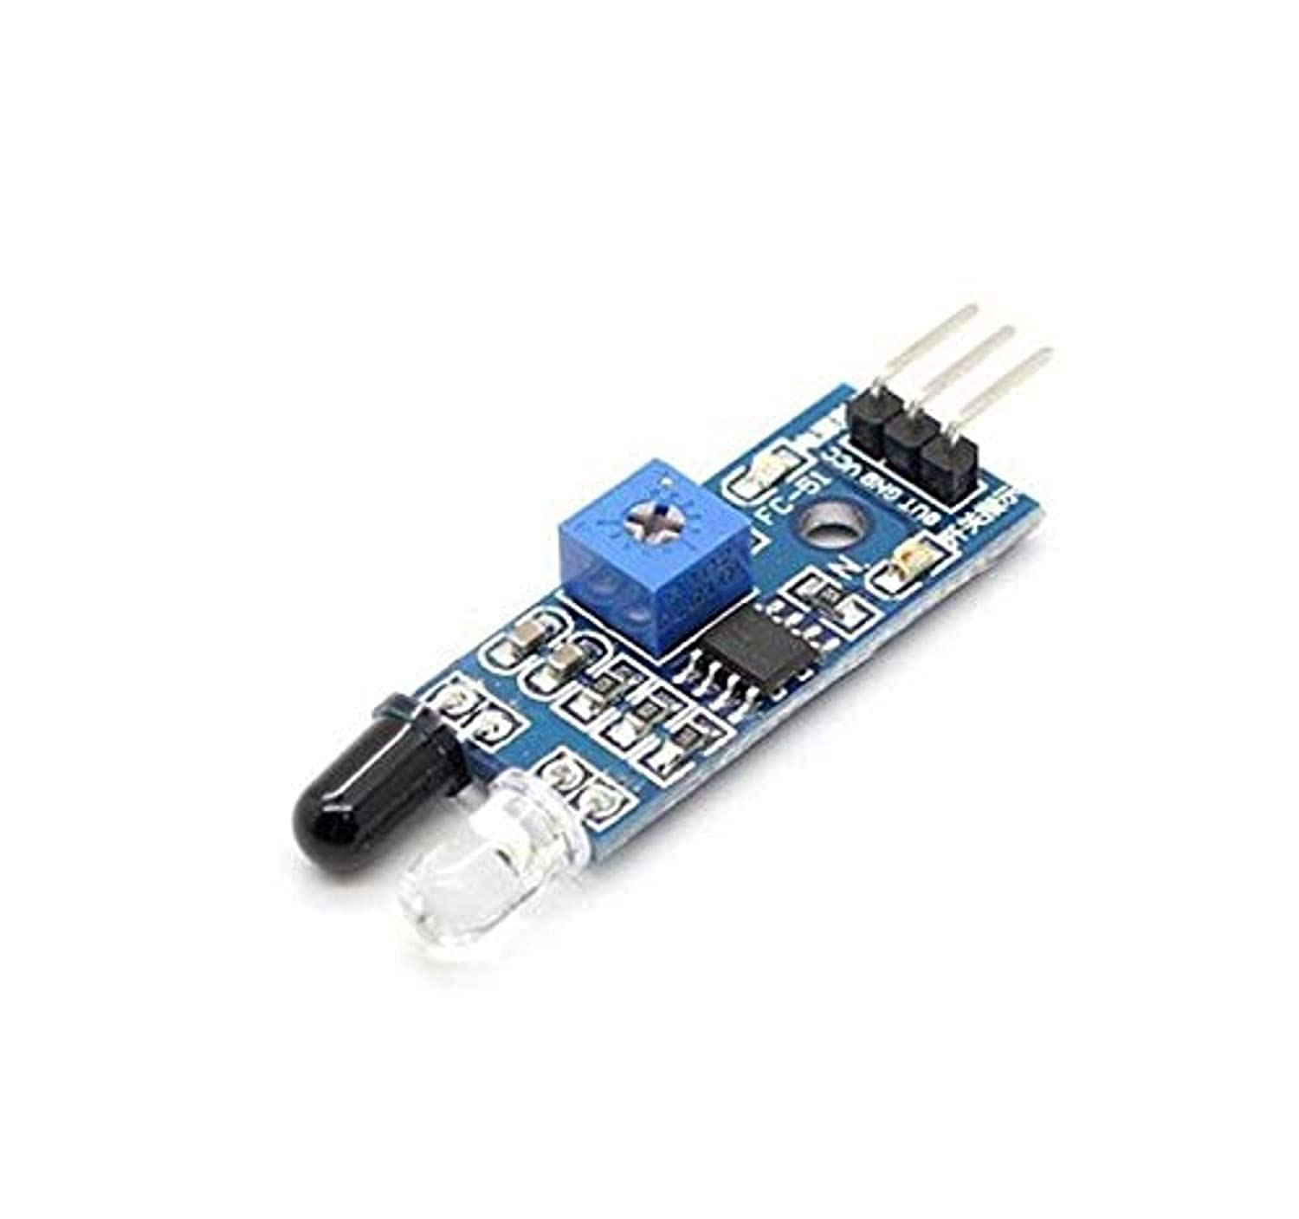
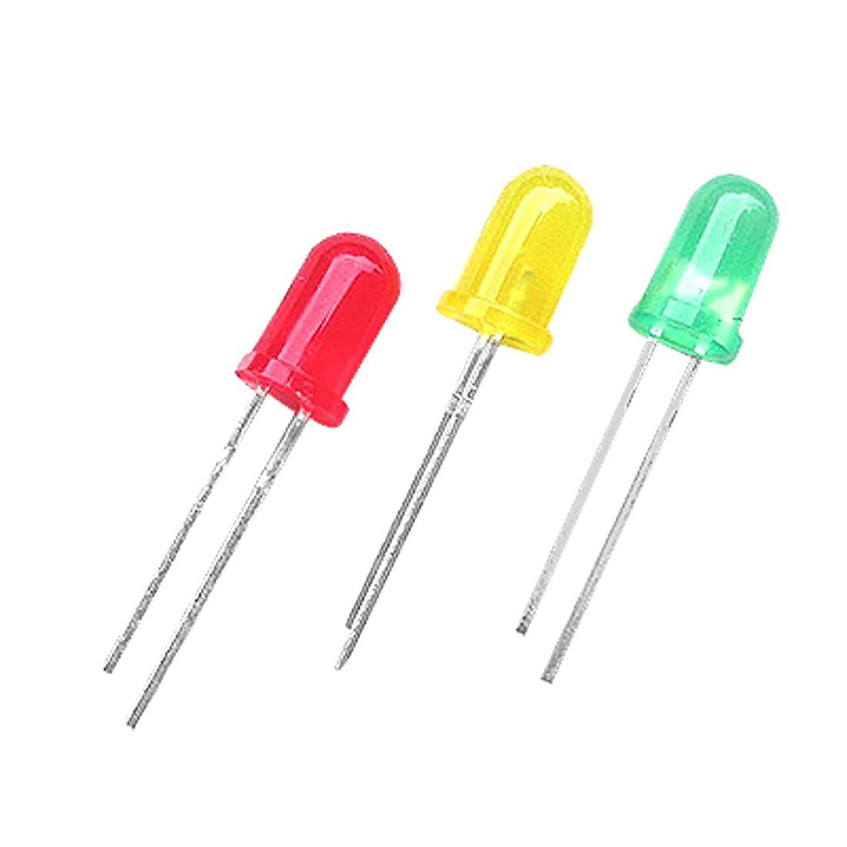
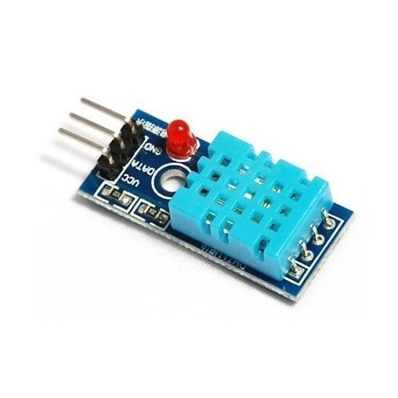
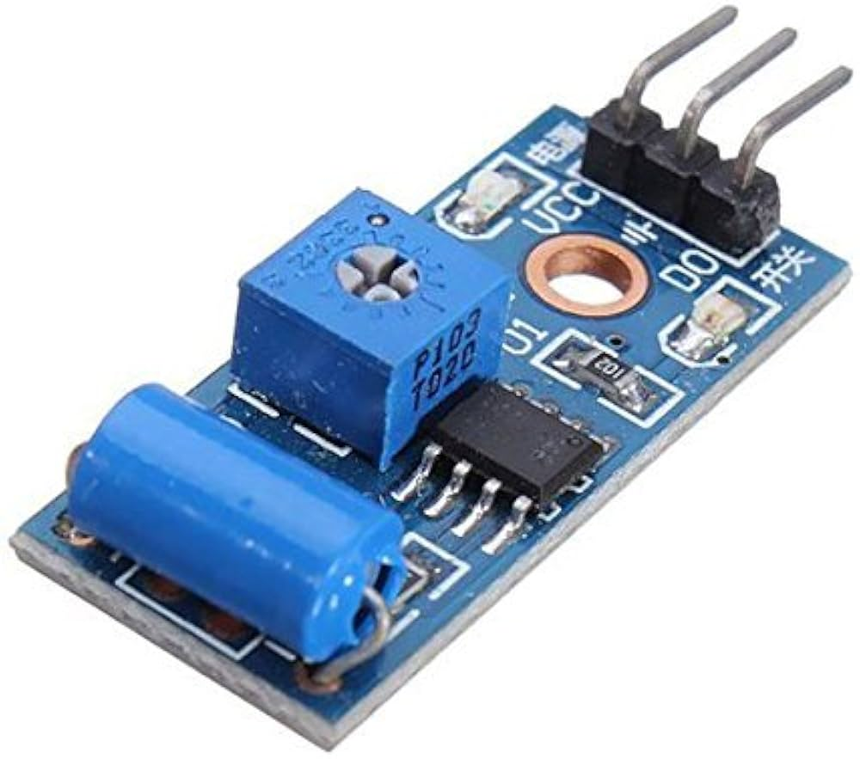
Components used

Slide 13
IDEA/APPROACH DETAILS
IDEA/APPROACH DETAILS
Section | Details
Novelty / Technical Advantages: | 1. Detection accuracy: >90% human vs animal vs vehicle. 2. Edge ML inference latency: <150 ms. 3. Energy consumption: ~0.5 W per node, lasting 4-6 months on a small solar panel + battery. 4. IR scatter detection: 3-5 m per node, LoRa communication: 1-3 km. 5. Network scalability tested: 20-30 nodes in pilot zone.
Market Analysis: | 1. Indian anti-poaching tech budget (central + state): ₹50-100 crore/year. 2. Number of high-risk reserves suitable for small deployments: ~200-300. 3. Camera traps replacement market (pilot-scale): ₹5-10 crore/year. 4. Growing interest from NGOs, eco-tourism, and forest research organizations.
Revenue Model: | 1. TrailGuard node hardware cost: ₹7,000-10,000 per unit. 2. InfraPalm ID authentication terminal: ₹15,000-20,000 per unit. 3. SaaS dashboard subscription: ₹30,000-50,000 / year per reserve. 4. Maintenance/service: ₹5,000-10,000 / node / year. Example pilot: 20-node deployment : initial investment ₹2-3 lakh, recurring yearly revenue ₹1-1.5 lakhs. SDK licensing or research collaborations: ₹1-2 lakh per partner.

Slide 14
IDEA/APPROACH DETAILS
Prototype Components:
• ESP32 multi sensor TrailGuard node
• IR scatter projector + receiver
• Vibration + low-resolution thermal sensor
• Solar unit with energy adaptive sleep cycles
• LoRa mesh communication
• Raspberry Pi gateway
• InfraPalm ID terminal for ranger authentication
Use Cases:
• Early detection of human intruders and poachers
• Monitoring wildlife movement across critical corridors
• Detecting vehicle entry in restricted zones
• Creating virtual boundaries where cameras fail
• Secure ranger check in and authenticated alert acknowledgement
• Long term wildlife data collection for ecological research

Slide 15
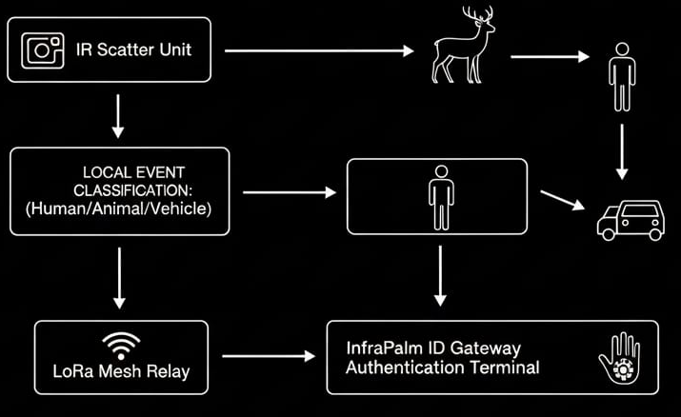
IDEA/APPROACH DETAILS
Technology Stack:
• Hardware: ESP32, Raspberry Pi, IR laser/LED sheet emitters, IR photodiode receivers, vibration sensors, thermal sensors, LoRa modules, solar charging system
• Software: Edge ML model on ESP32, Python/OpenCV on Raspberry Pi, LoRa mesh protocol, encryption for authentication templates
• Networking: Energy adaptive LoRa mesh, gateway-based event aggregation
• Biometric Layer: NIR illumination unit, palm-vein extractor, behavioural micro-movement module, encrypted local matching engine

Slide 16
IDEA/APPROACH DETAILS
Dependencies:
• Stable LoRa coverage between nodes
• Sufficient solar exposure for long term power
• Precise alignment between IR emitter and receiver
• Biometric database of authorised rangers
• Environmental calibration for different soil/leaf types
Potential Showstoppers:
• Very heavy rainfall or flooding can temporarily disrupt IR scatter patterns
• Thick undergrowth growth may occasionally cover node optics
• Low sunlight for extended monsoon periods may reduce battery longevity
• Biometric spoofing attempts require robust liveness detection
• Physical tampering requires protective enclosures

Slide 17
IDEA/APPROACH DETAILS
TEAM DETAILS
Team Leader Name: Jiya Kulkarni
Student ID: 1BY23ET023
Institution Name: BMS Institute Of Technology
Phone Number: 9742618452
Email ID: 1by23et023@bmsit.in
Member 1 Name : M Poojashri
Member 2 Name : Mandar Joshi
Member 3 Name : Manjunatha

